Slide 1



SAP Business One – Starter Package
Inecom Business Solutions DMCC
UAE, India, Singapore and Australia

Slide 2
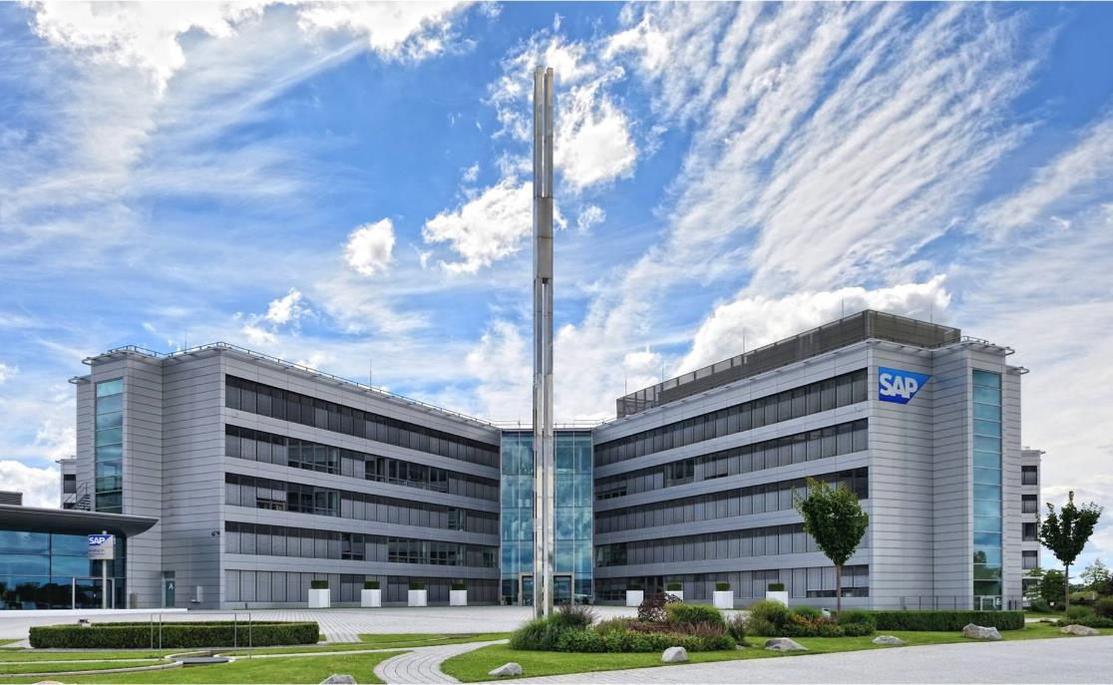
About SAP SE
Employees and Basic Facts
Headquarters: Walldorf, Germany
Founded: April 1, 1972
Listing: Frankfurt, New York
101,450 employees worldwide (09/30/2020)
  145 nationalities worldwide
Customers
SAP serves >440,000 customers in >180 countries
Approx. 80% of SAP’s customers are SME
77% of the world’s transaction revenue touches an SAP system
Market Position
SAP is market share leader in:
  Enterprise resource planning (ERP)
  Analytics
  Supply chain management
  Human capital management
  Experience management software & customer experience
Top Cloud Vendor
  Cloud user base: ~230m users
  65 datacenters in 35 locations in 16 countries

Slide 3

About INECOM Group
BASIC FACTS
Incorporated in 2000
Regional group with offices in UAE, India, Singapore & Australia
One-stop solution provider – ERP and Business Intelligence solution, hardware, cloud hosting, disaster recovery and managed services provision
INDUSTRY FOCUS
Wholesale Distribution
Manufacturing
Project-Based Industries
Service, Repair and Rental
ACCREDITATIONS
SAP Gold Partner since 2007
Top Partner for 2006, 2007, 2010… including 2021
Certified SAP Active Quality Management Partner since 2012
Top SAP Business One HANA Partner in Singapore for 2007, 2010, 2011, 2015, 2017-2019, 2021 and 2022
Top SAP Business One HANA Partner in Asia Pacific for 2016 and 2017
SAP 15 Years Outstanding Contribution Award in 2019
Innovation Partner of the Year in Southeast Asia for 2018
Top SAP Business One Partner in Southeast Asia for 2015
Star Achiever 2014 Upper Mid-market Asia Pacific
Achieved Certification for RISE with SAP S/4HANA Cloud 2022

Slide 4


























Our MNC Customers for SAP Business One

Slide 5
Inecom’s International Project Experience
Scotland
Netherlands
Canada
China
Switzerland
Korea
London
United States
Hong Kong
Japan
France
Dubai
Qatar
Thailand
Mexico
Taiwan
Saudi Arabia
Vietnam
Oman
Malaysia
India
Singapore
Indonesia
Australia
Johannesburg
Chile

Slide 6
SAP Business One

Slide 7






SAP Business One
SAP’s best selling ERP solution by number of customers
Used by 70,000+ customers
Available as 50 country localizations and in 28 languages
~300 Software Solution Partners with 500+ solutions
Implemented by more than 850 Value Added Resellers worldwide
SAP Business One is used in >170 countries
360+ large enterprises are running SAP Business One in 5,600+ subsidiaries

Slide 8
















SAP World’s Largest Business Software Company
SAP Business One The Digital Core for SME
Real-time
Analytics
Cloud
Technologies
Management
& Administration
Mobile
Workforce
Purchasing
& Operations
Accounting
& Financials
Internet of
Things (IoT)
Sales &
Service
Inventory &
Distribution
HANA in-memory
Industry Extensibility
Robotics &
Machine Learning
Project &
Resource
management
Production
& MRP
Business
Integration
Big Data

Slide 9
SAP Business One – Starter Package

Slide 10
SAP Business One – Starter Package
Start your Journey Now with SAP Business One on HANA - Starter Package
Get growing quickly, with SAP Business One starter package, addresses your fundamental business requirements with basic finance, sales, purchasing, customer relationship management, and inventory functionality. Forget standalone accountancy packages or spreadsheets, the SAP Business One starter package is designed to grow with you.
Affordable low total cost of ownership
Comprehensive all your departments needs from one solution
Quick and easy to implement, up and running in days or weeks
Powered by SAP HANA®
Powerful enough to help your business grow
Inecom Cloud which is powered by Microsoft Azure
Reduce the complexity of IT in your business.
Reports and dashboards to make decisions based on real-time information.
Upgrade anytime

Slide 11






Starter Package - Modules
Accounting and Finance All key accounting processes Manage cash flow Track fixed assets | Sales and CRM Sales and opportunity management Marketing campaign management Customer database management | Purchasing and Supplier Management Manage the procurement process Complete order-to-pay cycle Warehouse and accounting integration
Inventory and Distribution Manage inbound and outbound shipments Warehouse management, bin location Production and material planning | Reporting and Analytics Create customized reports Intuitive, easy to use, attractive interface Pre-defined and customizable KPIs | Management & Administration User Administration Authorization Multiple Currencies Exchange rate Multiple branches

Slide 12
Starter Package – Detailed Feature List

Slide 13

Starter Package Features & Reports
SAP Business One Client
Web Client
Mobile
Reports/Dashboards
Management
& Administration
Accounting
& Financials
Purchasing
& Operations
Sales & CRM
Inventory
& Distribution
Mobile App
User administration
Authorizations
Multiple currencies
Exchange rates
Posting period
Multi-branch
Data Import & Export
Opening balances
Mobile Interaction
Recurring transactions
Chart of accounts
Journal entries
Posting templates
Recurring postings
Financial reports
Cost accounting
Incoming payments
Outgoing payments
Bank statement processing
Checks & credit cards
Account reconciliation
Reports
Balance sheet
Trial balance (Branch wise)
Profit and loss (cost center wise)
Aging
Purchase orders
Goods receipt POs
Goods returns
A/P Invoice
Down-payment Invoice
Down-payment request
Cancel Marketing Documents
A/P credit memos
Reports
Purchase Analysis
Last Price report with different Selections
Sales Quotation
Sales order
Opportunity & Pipeline
Management
CRM
Delivery Note
Returns
Sales Invoice
Credit Note
AR down payment
Gross profit calculation
Reports
Back Order
Sales Analysis
Monthly Customer Status
Item management
Item lists
Price lists
Goods receipts
Goods issues
Inventory transactions
Transfers
Serial number mgmt
Batch number mgmt.
Special prices
Period and volume
discounts
Recurring transactions
Inventory Tracking
Inventory Counting
Reports
Inventory Audit report
Inventory in warehouse
Batches and Serials
Inventory Audit Report
Activities
Sales Quotation
Sales order
Customer
Items
Delivery
Invoices
Alert

Slide 14
Inecom Cloud powered by Microsoft Azure

Slide 15


SAP B1 on SAP HANA with CCC – Cloud Hosted
Server
SAP Certified Data Center
HTTPS Site
Primary Servers in Singapore
- RTO : 1 hour
- RPO : 15 mins
Deployment using SAP CCC Technology
24 x 7 Availability
99.99% SLA
Azure Monitor
Azure WAF (Web Application Firewall)
Key Benefits
Easy and affordable deployment Secure browser-based access from anywhere, at any time Access to the most up-to-date functionality without having to use rely on in-house IT resources to maintain the solution Subscription licensing avoiding capital expenditure and allowing for operational expenditure flexibility You get access to the world class datacenters from Manage your most critical business functions in your Web browser. Inecom Cloud also provides you enhanced security for your data and your application

Slide 16
Rapid Implementation

Slide 17
Starter Package – Implementation Methodology
We will enable SAP Business One starter pack for you within weeks with our Rapid and Remote Implementation Methodology
  Step 1: Activate (1 - day)
  You will be onboarded on Inecom's Azure Cloud for SAP Business One version for SAP HANA
  User IDs and Passwords will be set-up for your users
  UAT and Production DBs will be created for your company
  Step 5: Opening Balance Upload (2 days)
  Excel Templates for collection of Opening Balance data will be provided for:
  Customer Balances
  Vendor Balances
  GL Balances
  Open Sales Orders
  Open Purchase Orders
  Step 2: Software Configuration (3 - days)
  All software modules will be configured by our SAP Consultant in discussion with your Project Manager / Key User(s)
  Day 1: General Ledger - Chart of Account
  Day 2: Sales Enquiry to Cash
  Day 3: Procure to Pay
  Step 6: End User Training (3 days)
  Users shall be trained based on your company data in a Training DB on:
  Day 1: Sales Enquiry to Cash
  Day 2: Procure to Pay
  Day 3: Financials
  Step 3: Master File Upload (2 days)
  Excel Templates for collection of Master File data will be provided for:
      Customers
      Suppliers
      Items
  Upload of Master File in SAP
  Step 7: Go-live Support (2 days)
  An SAP Consultant will be available for support for 2 days once your users start using the Production DB for live data entry
  Step 4: User Acceptance Test (2 days)
  The software will be demonstrated to your Project Manager / Key Users based on your data
  Day 1: Sales Enquiry to Cash
  Day 1: Procure to Pay
  Day 2: P&L and Balance Sheet

Slide 18
SAP B1 Starter Package Pricing

Slide 19





Starter Package - Pricing
$99 per user per month
Valid for only the first 20 customers
Includes
SAP Business One - HANA
Starter Pack on Cloud
Implementation Cost -
Starter Package
Standard Ongoing
Support
Inecom – Azure Cloud Hosting
Applicable taxes will be charged in addition to the prices mentioned.
Helpdesk Support will be charged additional if required
Minimum Contract Period 12 months

Slide 20

Thank You!
Inecom Business Solutions DMCC
Inecom Business Solutions DMCC – Unit No. 6, 5th Floor, Jewellery & Gemplex 2 Dubai – United Arab Emirates
+971 55 772 1702

